Slide 1
Simulating Natural Viewing Conditions for 3D Perception in Lightness Discrimination Experiments Using VR
Devin Reynolds
Dr. Vijay Singh
National Science Foundation (BCS-2054900)

Slide 2
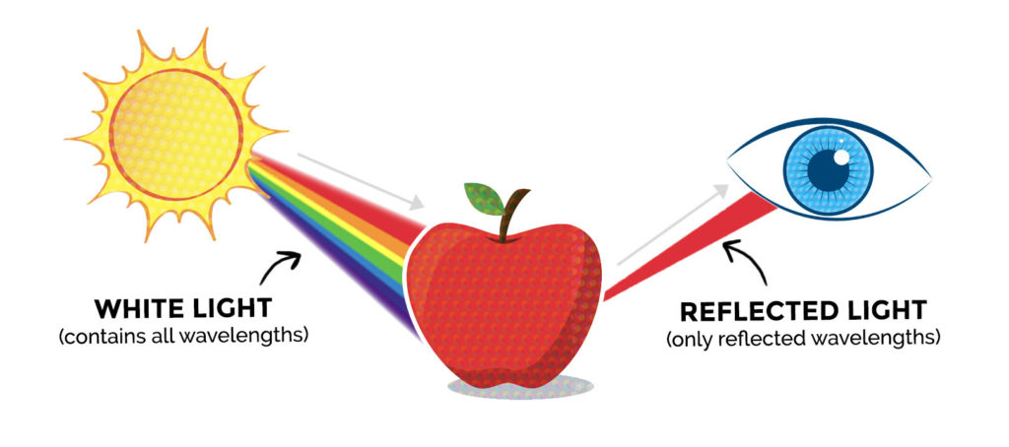
Color
Color: Brain's reaction to spectra absorbed in the eyes
Achromatic Special Case: Lightness
Spectra: The amount of light across all wavelength of light

Slide 3
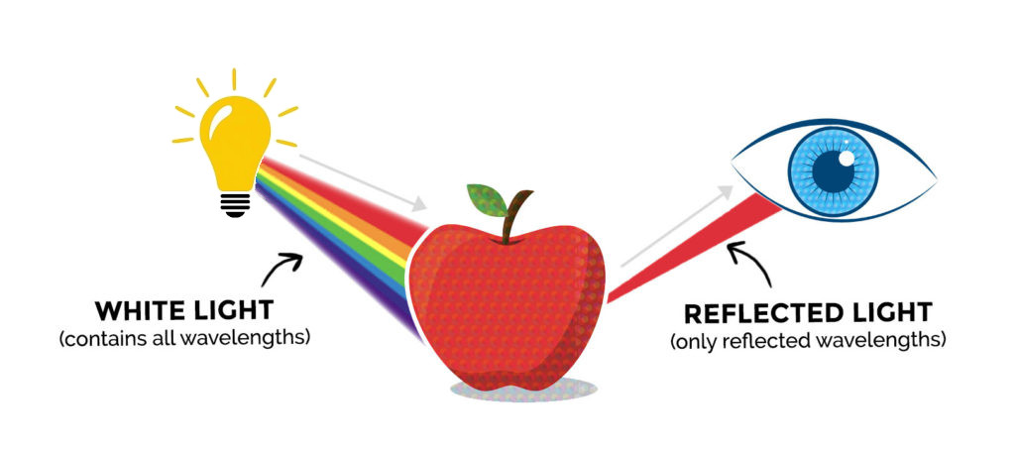
Color Constancy
The human visual system provides a relatively constant representation of the color of objects despite variation in external factors.
External Factors:
Spectra of light source
Spectra of background objects
Position of objects
Position of observer
Same perceived color despite changing the light source.
Brainard D. H. (2009). Color constancy. In Goldstein B. (Ed.), The Sage encyclopedia of perception (pp. 253–257). Los Angeles: SAGE Publications.

Slide 4
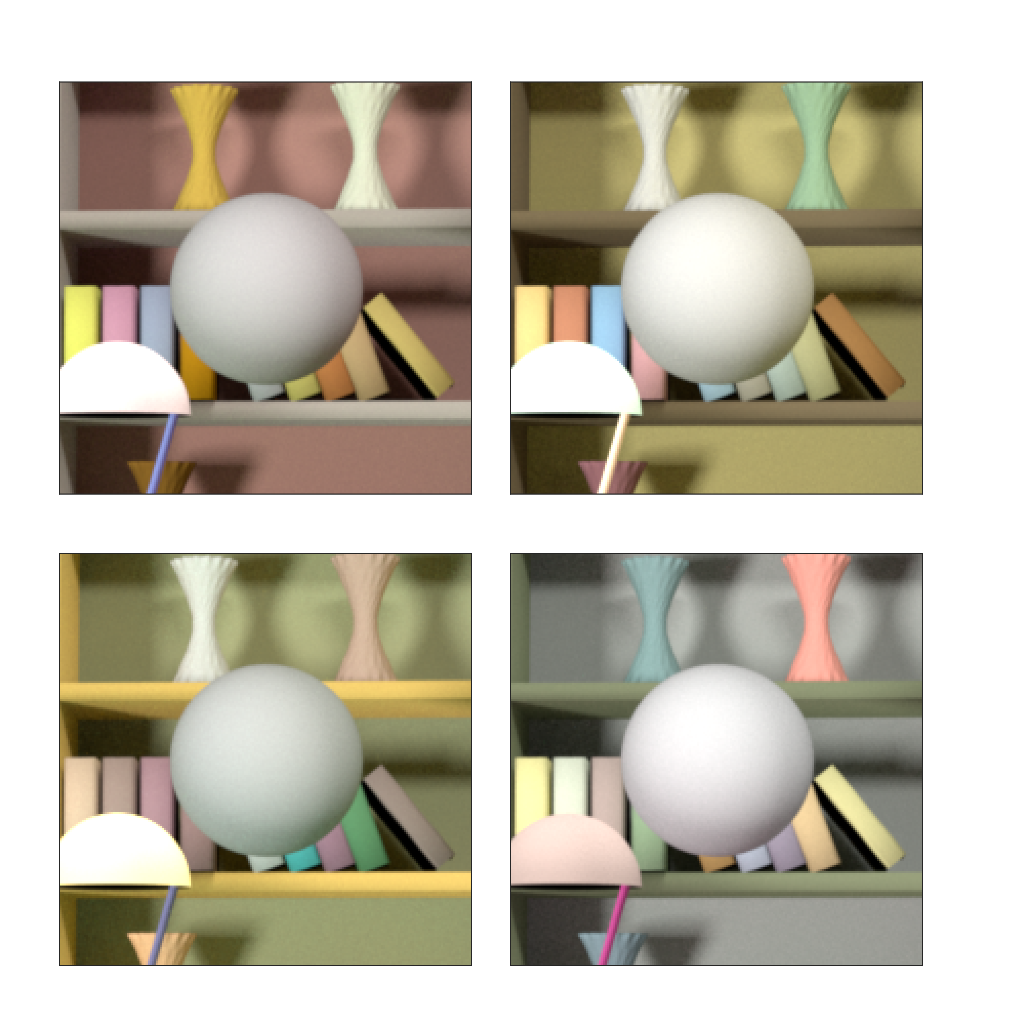
Previous Experiments
Two naturalistic rendered images are displayed to a human subject and they report which image they think contains the lighter sphere
Images are displayed on monitor
Not representative of natural viewing conditions
Which sphere is lighter?

Slide 5
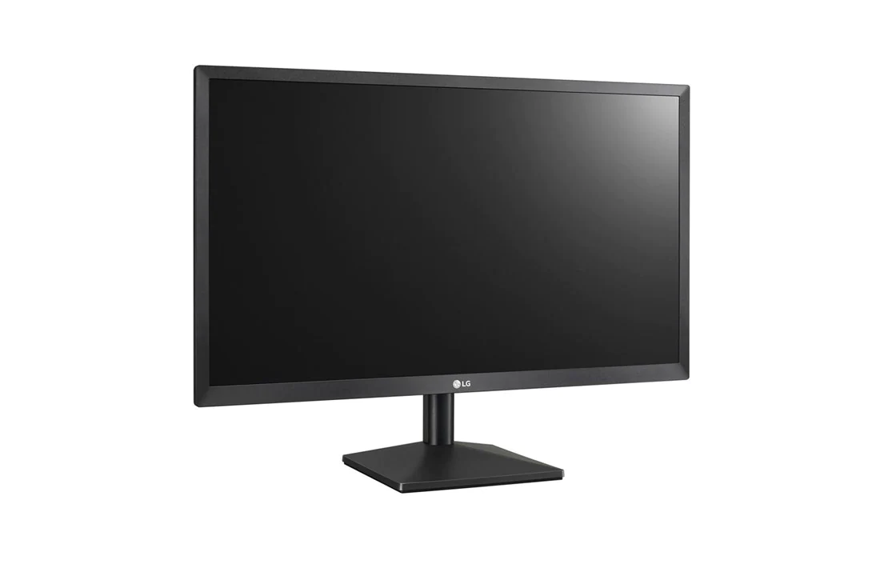
Natural Viewing Conditions
In previous experiments, 2D images are displayed to a subject on a monitor
The same image is presented to both eyes
Images are 2D
In natural vision, the two eyes view the same scene from two slightly different positions
This difference in position results in different images the eyes see
Images contain 3D information

Slide 6
3D Perception and Binocular Cues
Binocular Cues provide depth information to animals that have two eyes
Stereopsis
Convergence

Slide 7
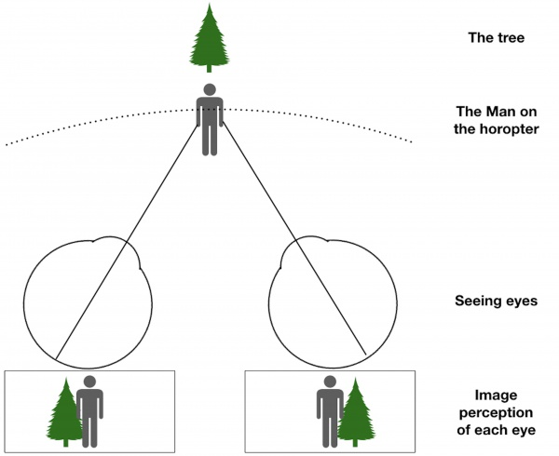
Stereopsis
Animals with two frontal eyes can use images obtained from two different angles of an object to judge the distance of the object
The disparity of the two images allow for animals to accurately judge the distance of an objects relative to other objects
McCoun, J., & Reeves, L. (Eds.). (2010). Binocular vision : Development, depth perception and disorders : development, depth perception and disorders. Nova Science Publishers, Incorporated.

Slide 8
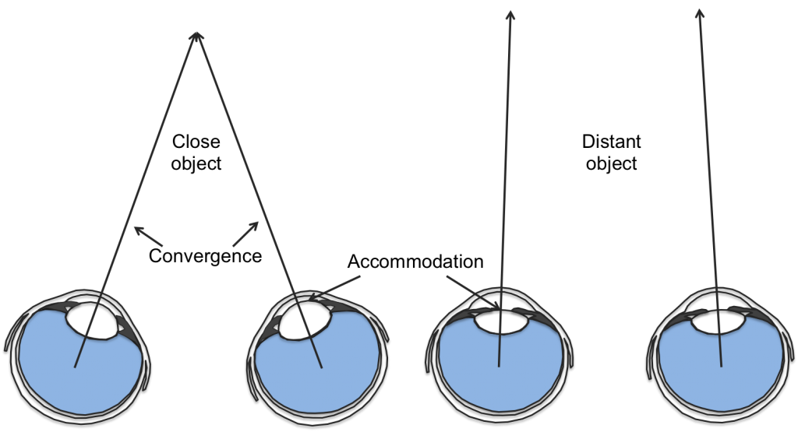
Convergence
Convergence occurs when the two eyes focus on the same object
Allows for animals to accurately judge the distance of an objects relative to other objects
Only effective for distances less than 10m
McCoun, J., & Reeves, L. (Eds.). (2010). Binocular vision : Development, depth perception and disorders : development, depth perception and disorders. Nova Science Publishers, Incorporated.

Slide 9
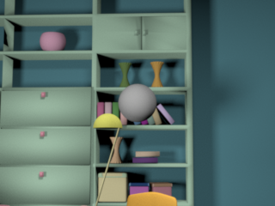
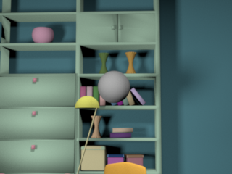
Stereoscopic Pairs
Set’s of two images taken from two slightly different positions, representative of the two visual images from the two eyes
A second image is rendered 63mm away from the first
Left Rendered Image
Right Rendered Image

Slide 10
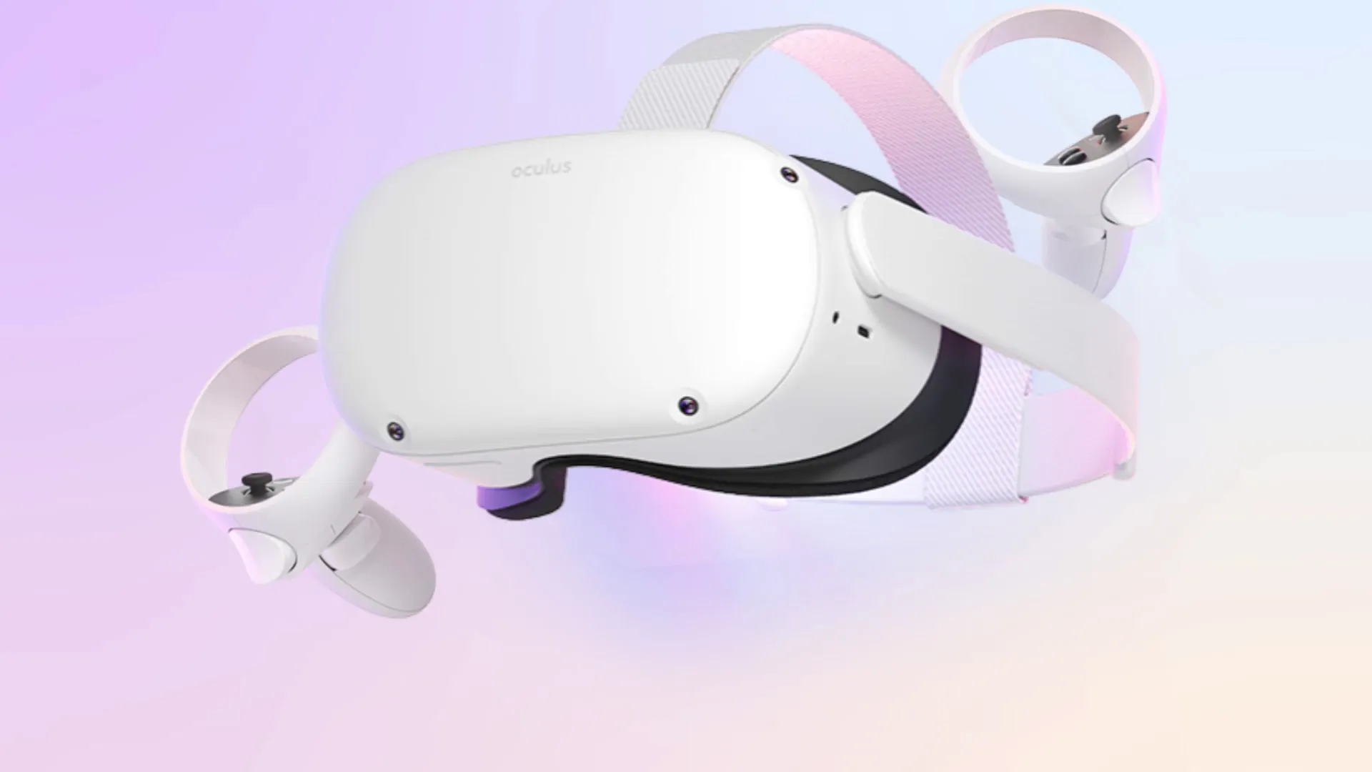
Virtual Reality
Virtual Reality (VR) uses near eye displays to provide a immersive experience of a simulated virtual world
VR allows us to control what is displayed to each eye individually
Meta Quest 2
Total Horizontal FOV: 104°
Resolution: 1832×1920
IPD Values: 58mm, 63mm, 68mm

Slide 11
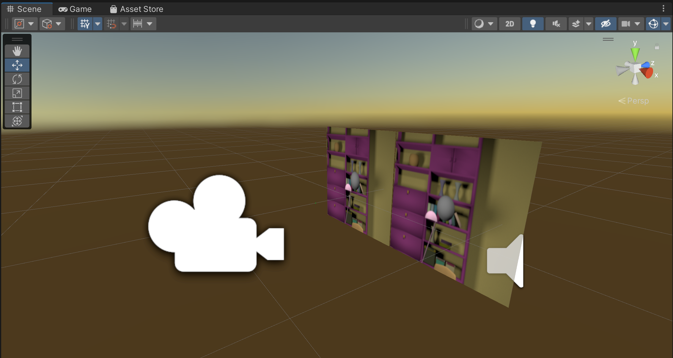
Unity
Unity’s editor allows us to present stimuli through a VR headset while simultaneously viewing it on a monitor
The stereoscopic pairs can be placed inside a scene along side camera’s that would correspond to the left and right eyes

Slide 12
Displaying Stereoscopic Pairs
These image pairs need to be displayed only to their corresponding camera
Unity’s layers tool and the cameras’ culling mask are used together to render selective parts of the scene per camera
Unity’s layers tool categorizes objects in a scene into layers
A camera’s culling mask render’s selective layers to said camera

Slide 13
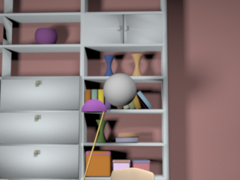
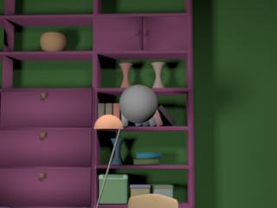
Lightness Discrimination Task
Which spheres is lighter?
Two naturalistic rendered stereoscopic pairs containing a monochromatic sphere are displayed to a subject
Standard Image
Always has a lightness value of 0.4
Comparison Image
Lightness value is one of 11 evenly spaced values from 0.35 to 0.45
The subject reports which pair they think contains the lighter sphere
Standard
Comparison

Slide 14
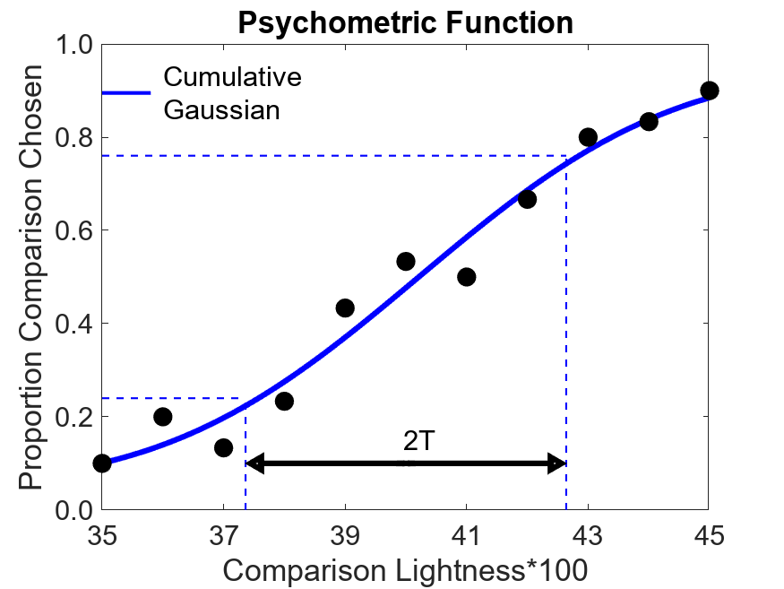
Thresholds
Quantify performance
Chosen to be 50%-76% difference of the comparison image chosen along the fitted cumulative gaussian
In previous works, we tested how these thresholds change in the presence of external variation

Slide 15


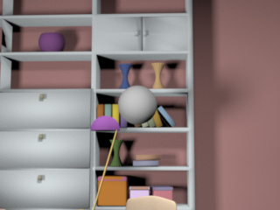
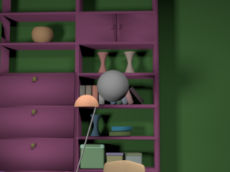
Conditions
No Variation
Natural Variation
Standard
Standard
Comparison
Comparison
Left
Right
Left
Right
The color of the background objects are fixed
The color of the background objects can change between images

Slide 16
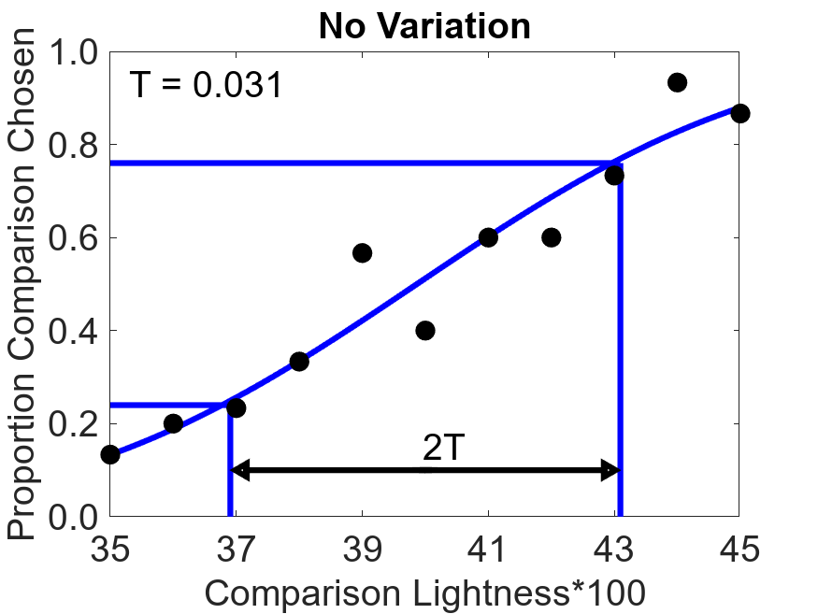
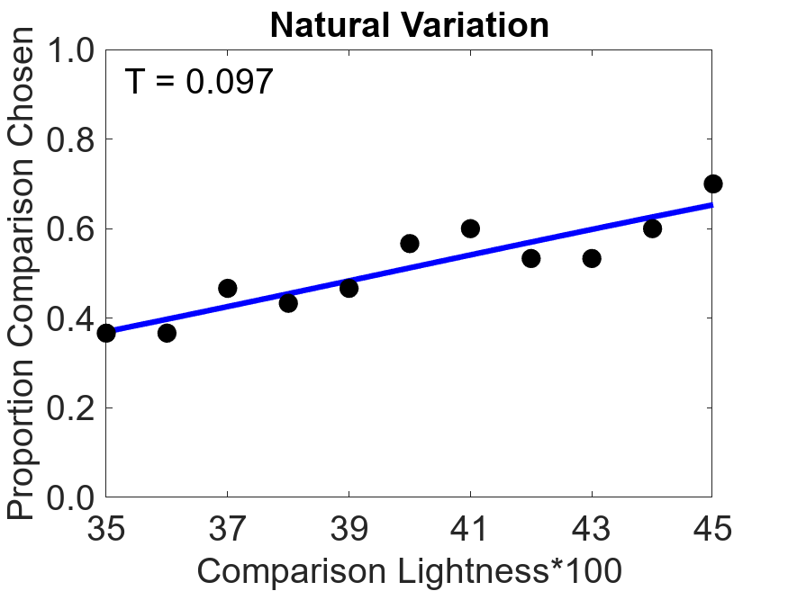
Results
One pilot test subject
30 comparisons across each of the comparison lightness values
This gives similar thresholds to previous experiments on a monitor
Previous work concluded that thresholds increase with variation

Slide 17
Summary
Use VR to control what’s displayed to individual eyes
Binocular cues provide 3D information to our rendered 2D images
Interface headset with Unity to display the images to the headset
With this set-up, which is representative of natural viewing conditions, we can now run psychophysical experiments

Slide 18
Acknowledgments/References
References:
Brainard D. H. (2009). Color constancy. In Goldstein B. (Ed.), The Sage encyclopedia of perception (pp. 253–257). Los Angeles: SAGE Publications.
McCoun, J., & Reeves, L. (Eds.). (2010). Binocular vision : Development, depth perception and disorders : development, depth perception and disorders. Nova Science Publishers, Incorporated.
Also see:
Singh, V., Burge, J., & Brainard, D. H. (2022). Equivalent noise characterization of human lightness constancy. Journal of Vision, 22(5). https://doi.org/10.1167/jov.22.5.2
Pre-Registrations available at: https://osf.io/7tgy8/
Thanks:
Joel Oluyole
Jonathan Rinaldi
Chibuike Okekeogbu

